Slide 1
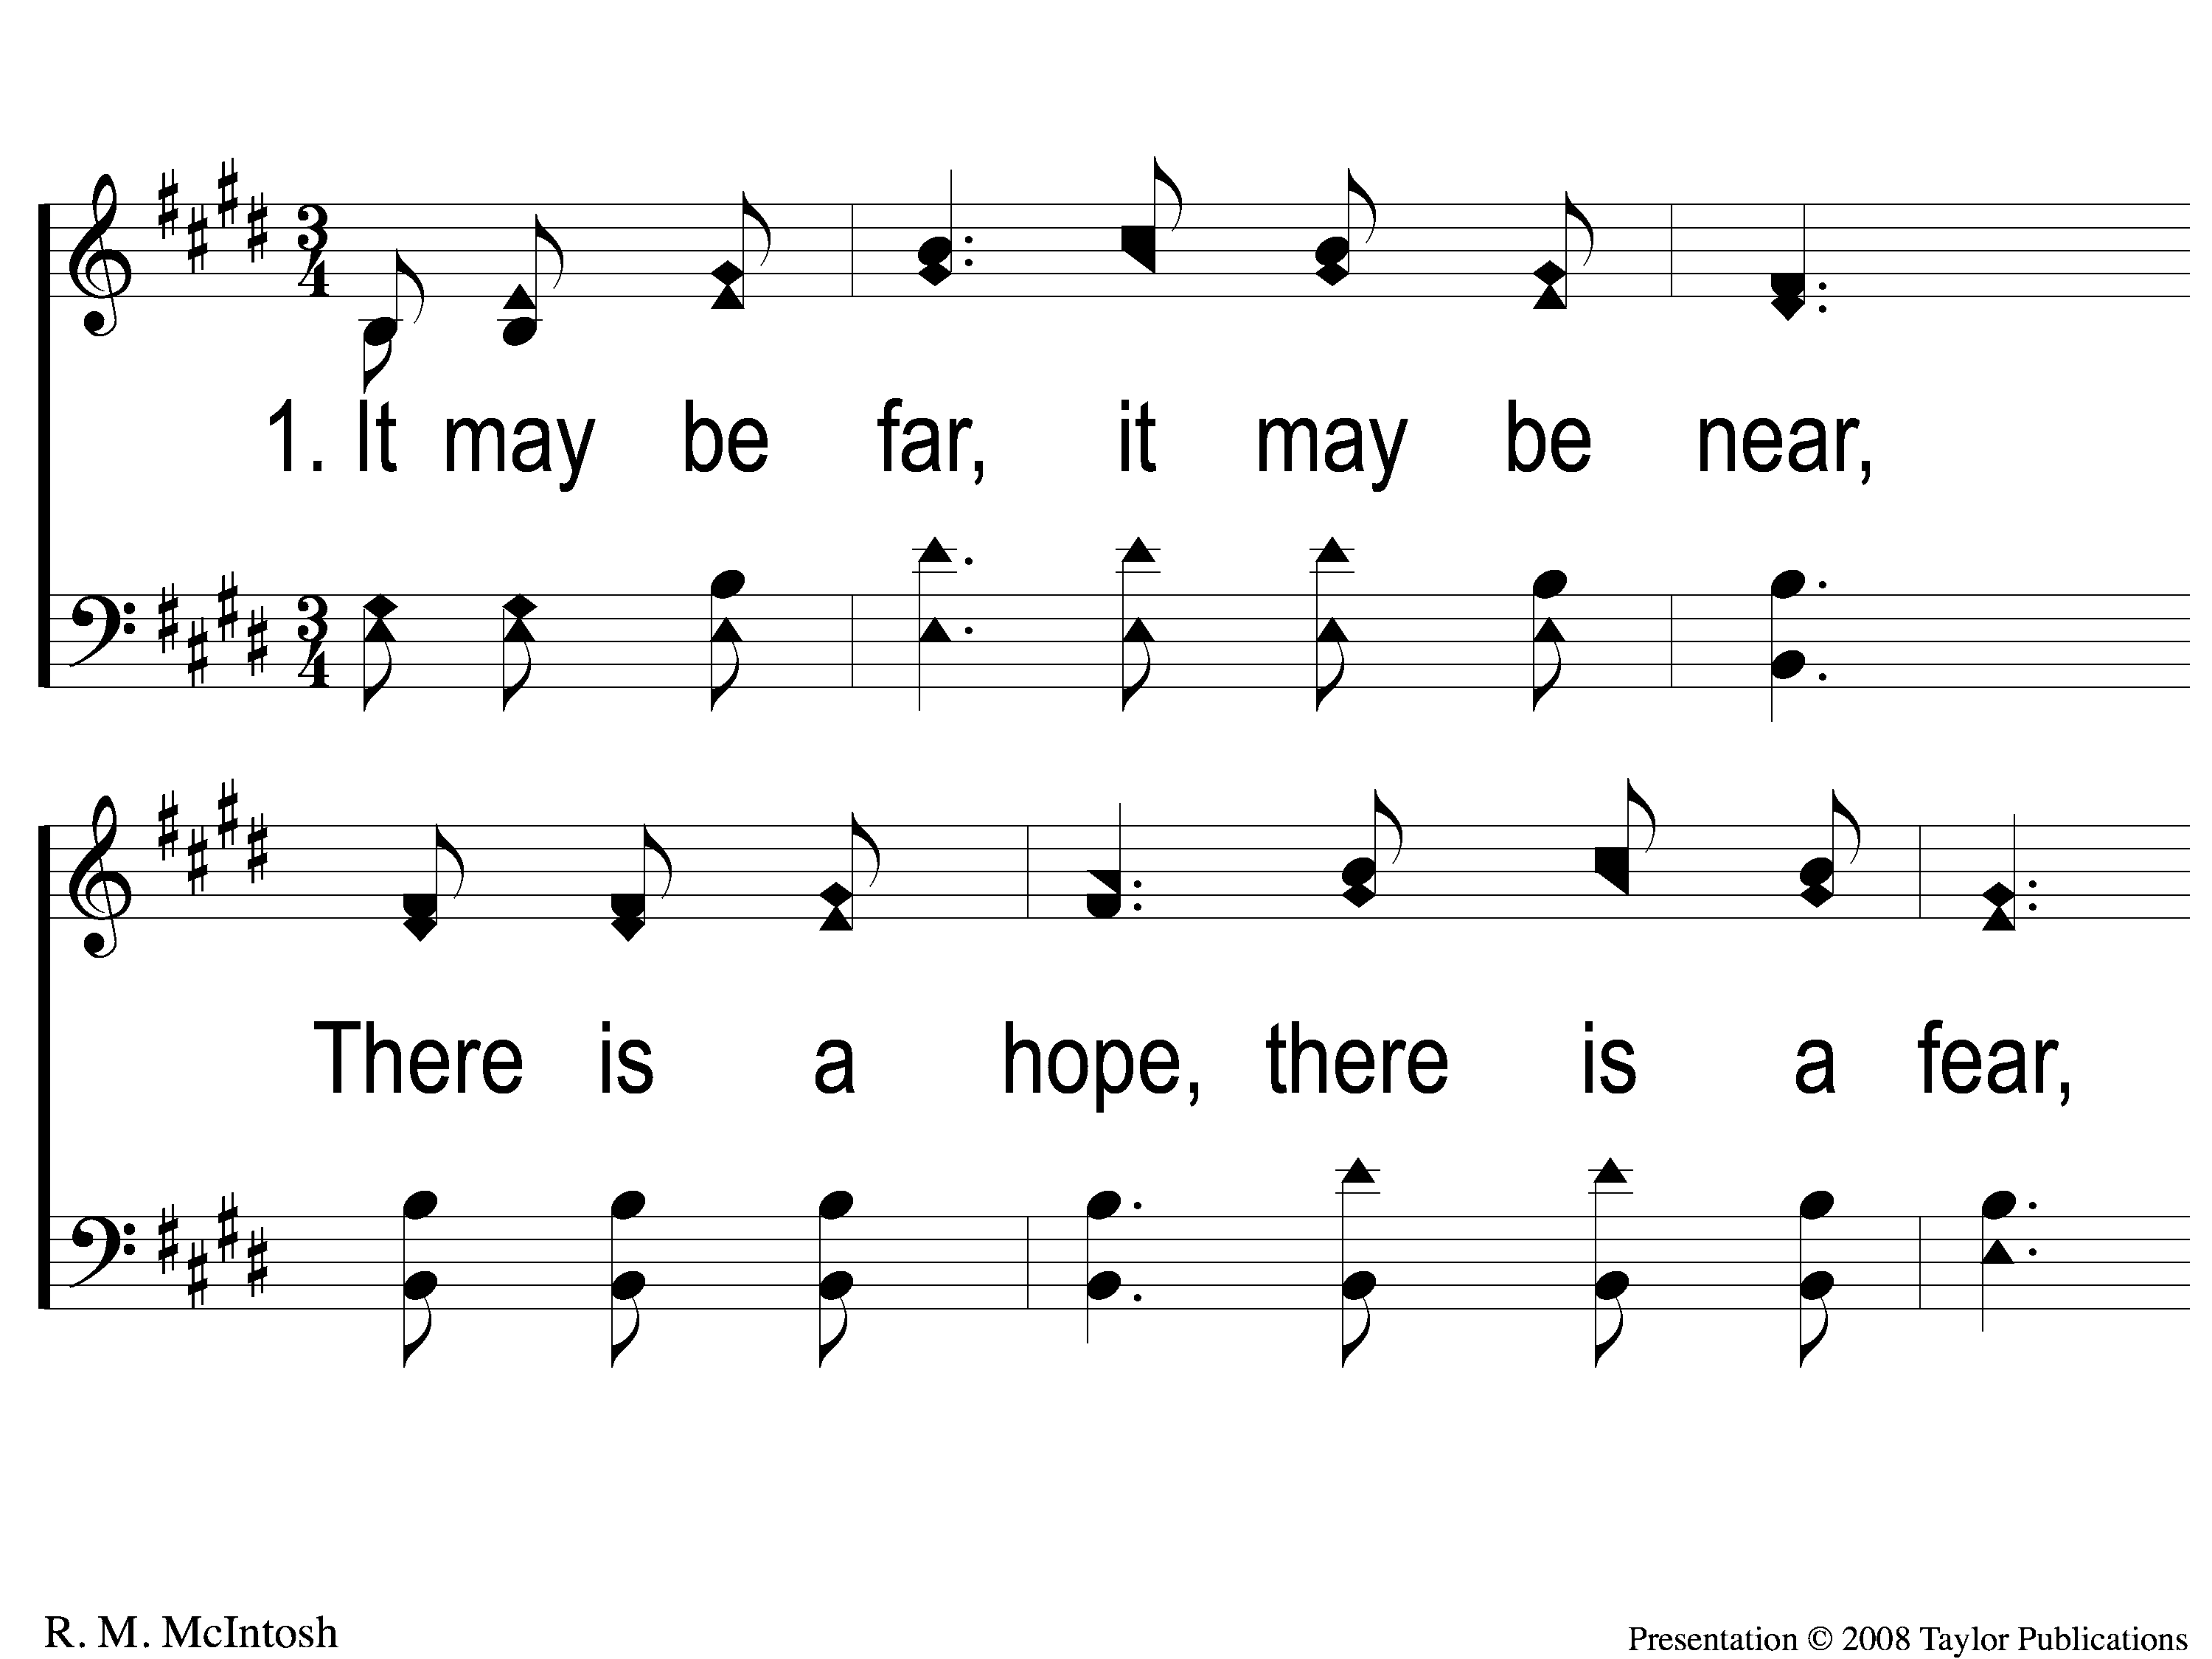
1-1 By and By
By and By
59

Slide 2
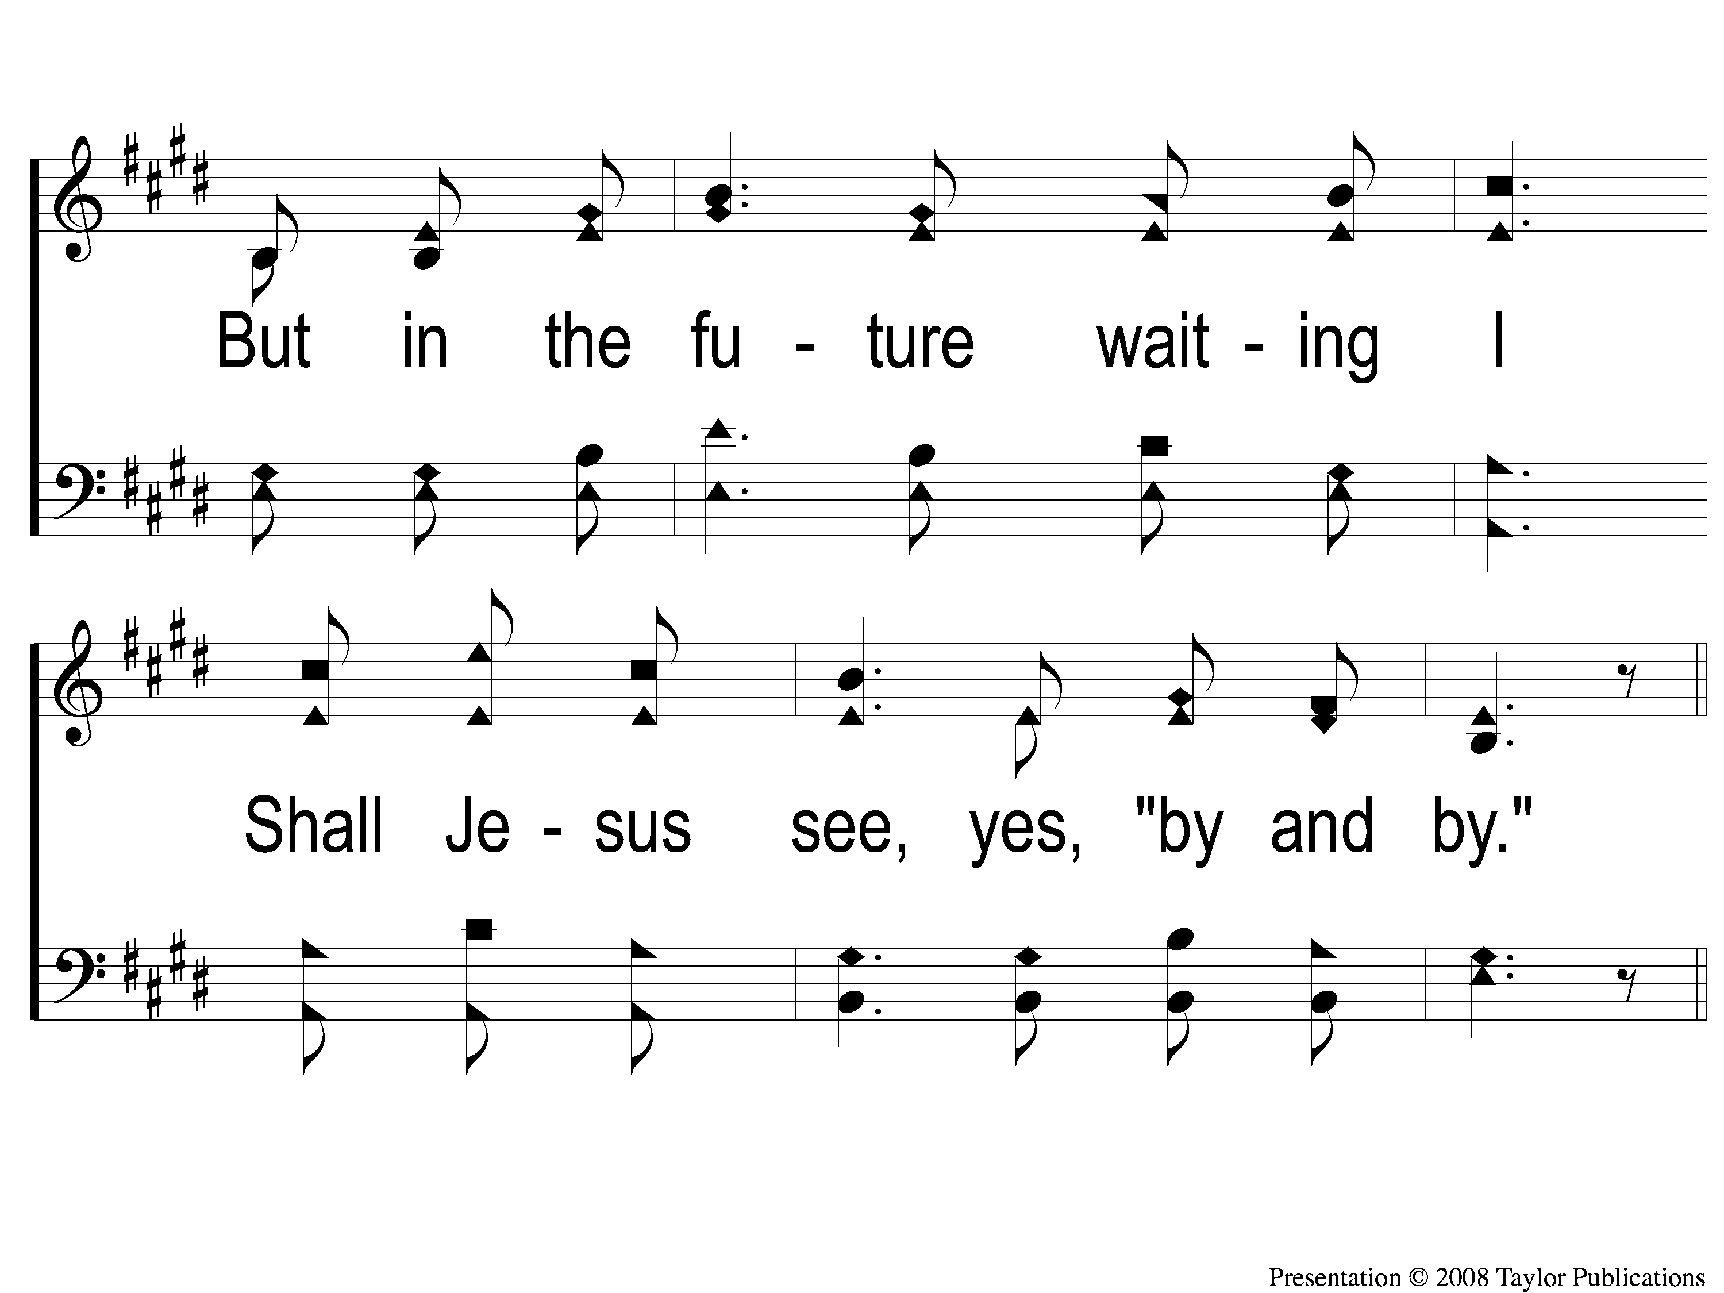
1-2 By and By
By and By
59

Slide 3
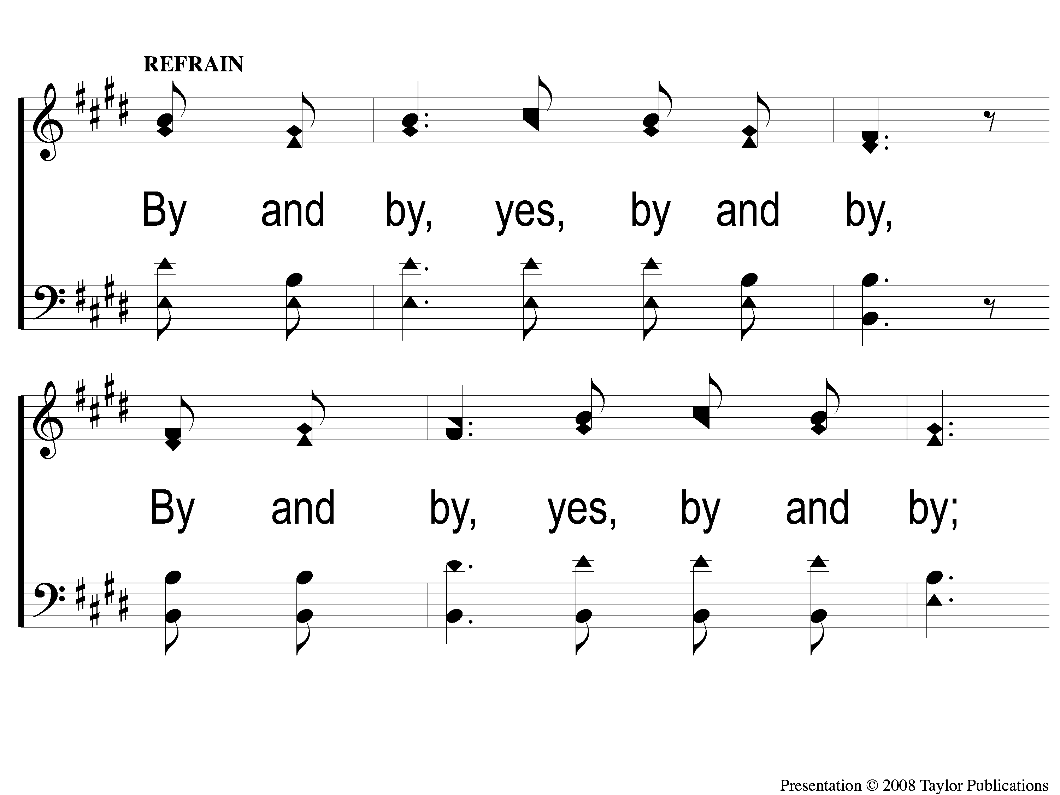
1-3 By and By
By and By
59

Slide 4
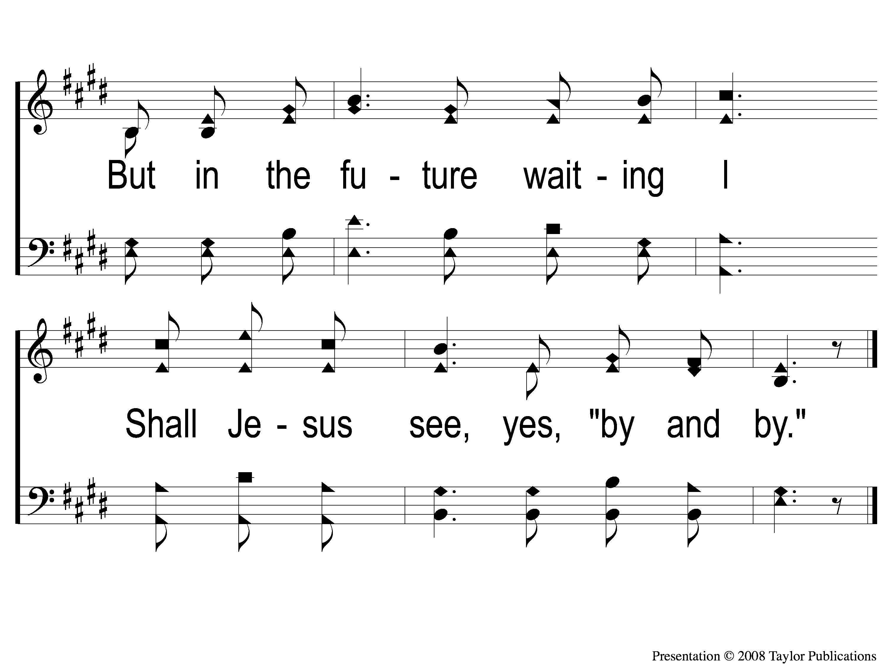
1-4 By and By
By and By
59

Slide 5
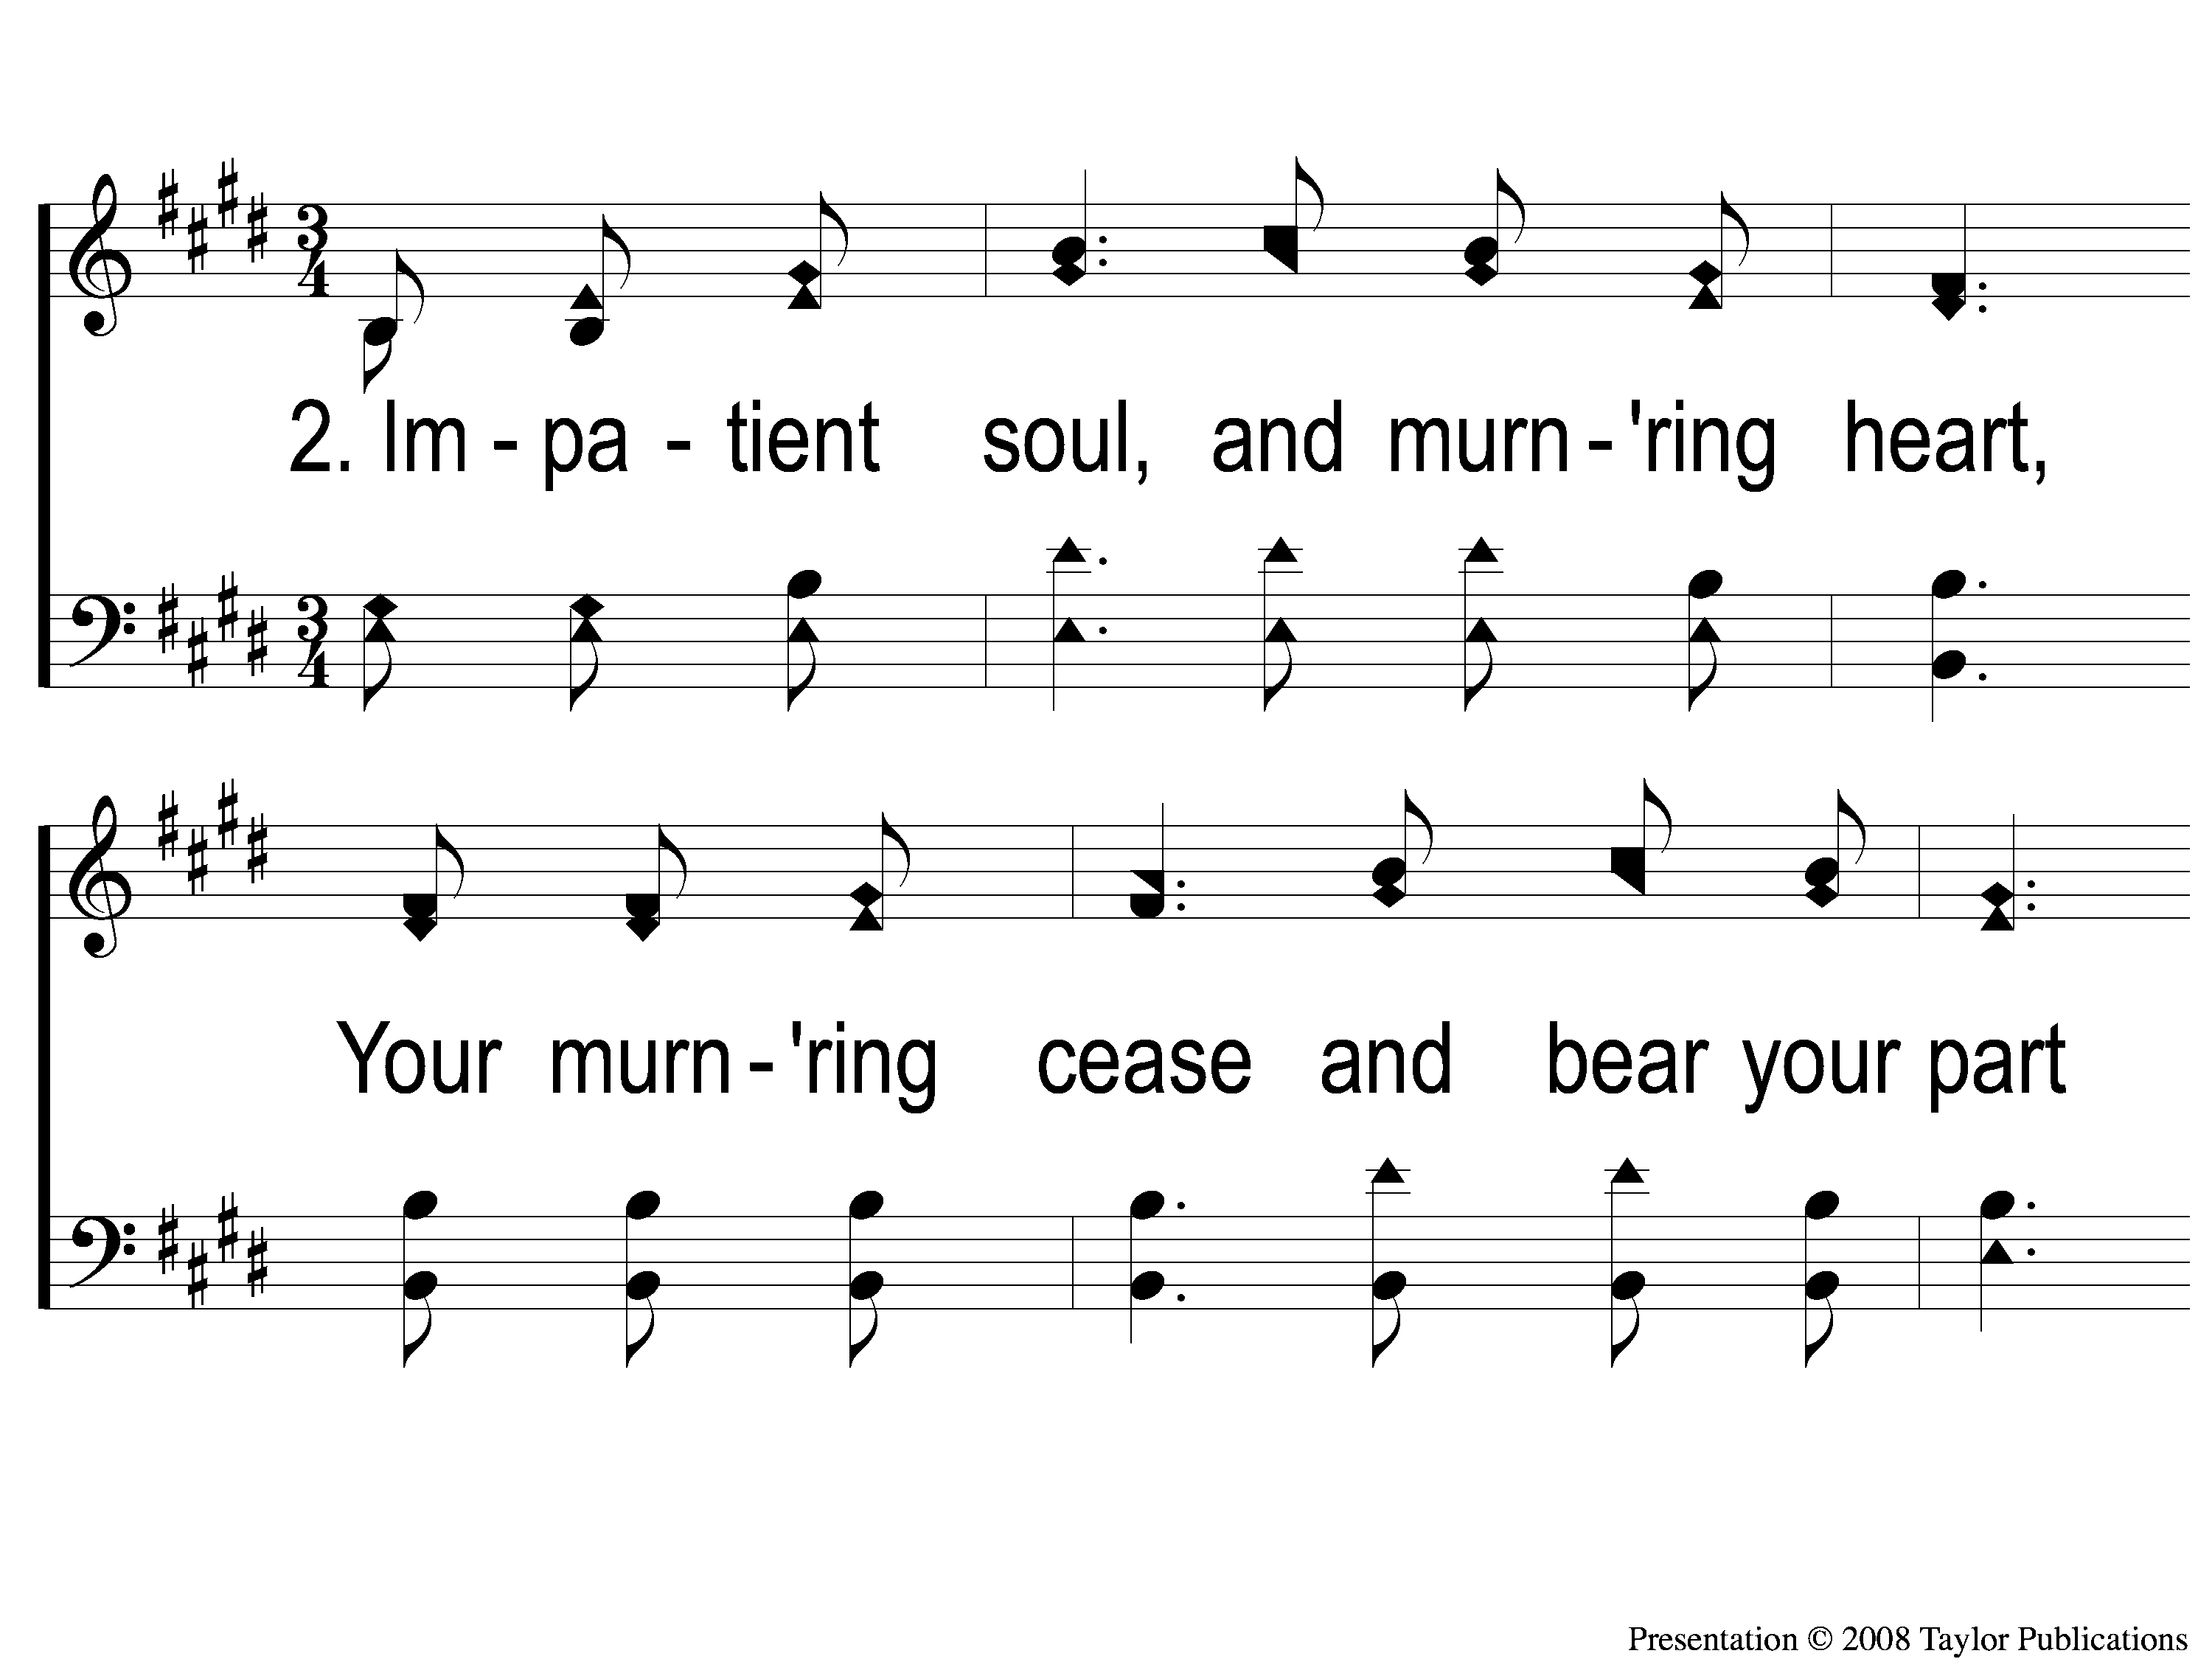
2-1 By and By
By and By
59

Slide 6
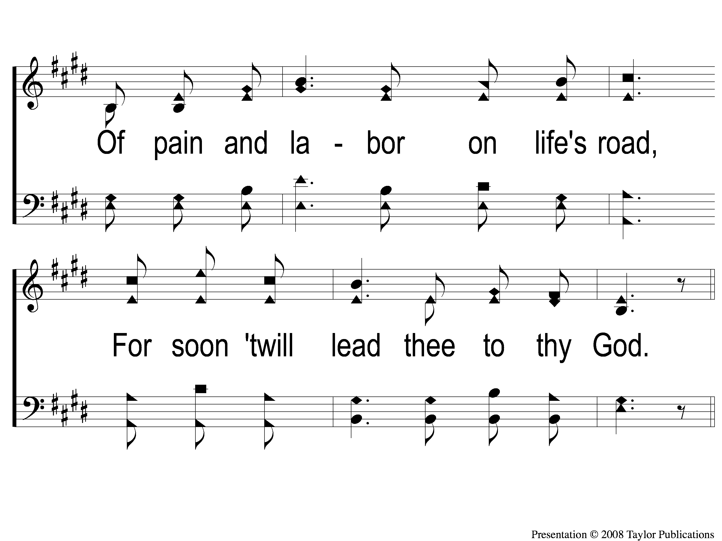
2-2 By and By
By and By
59

Slide 7
2-3 By and By
By and By
59

Slide 8
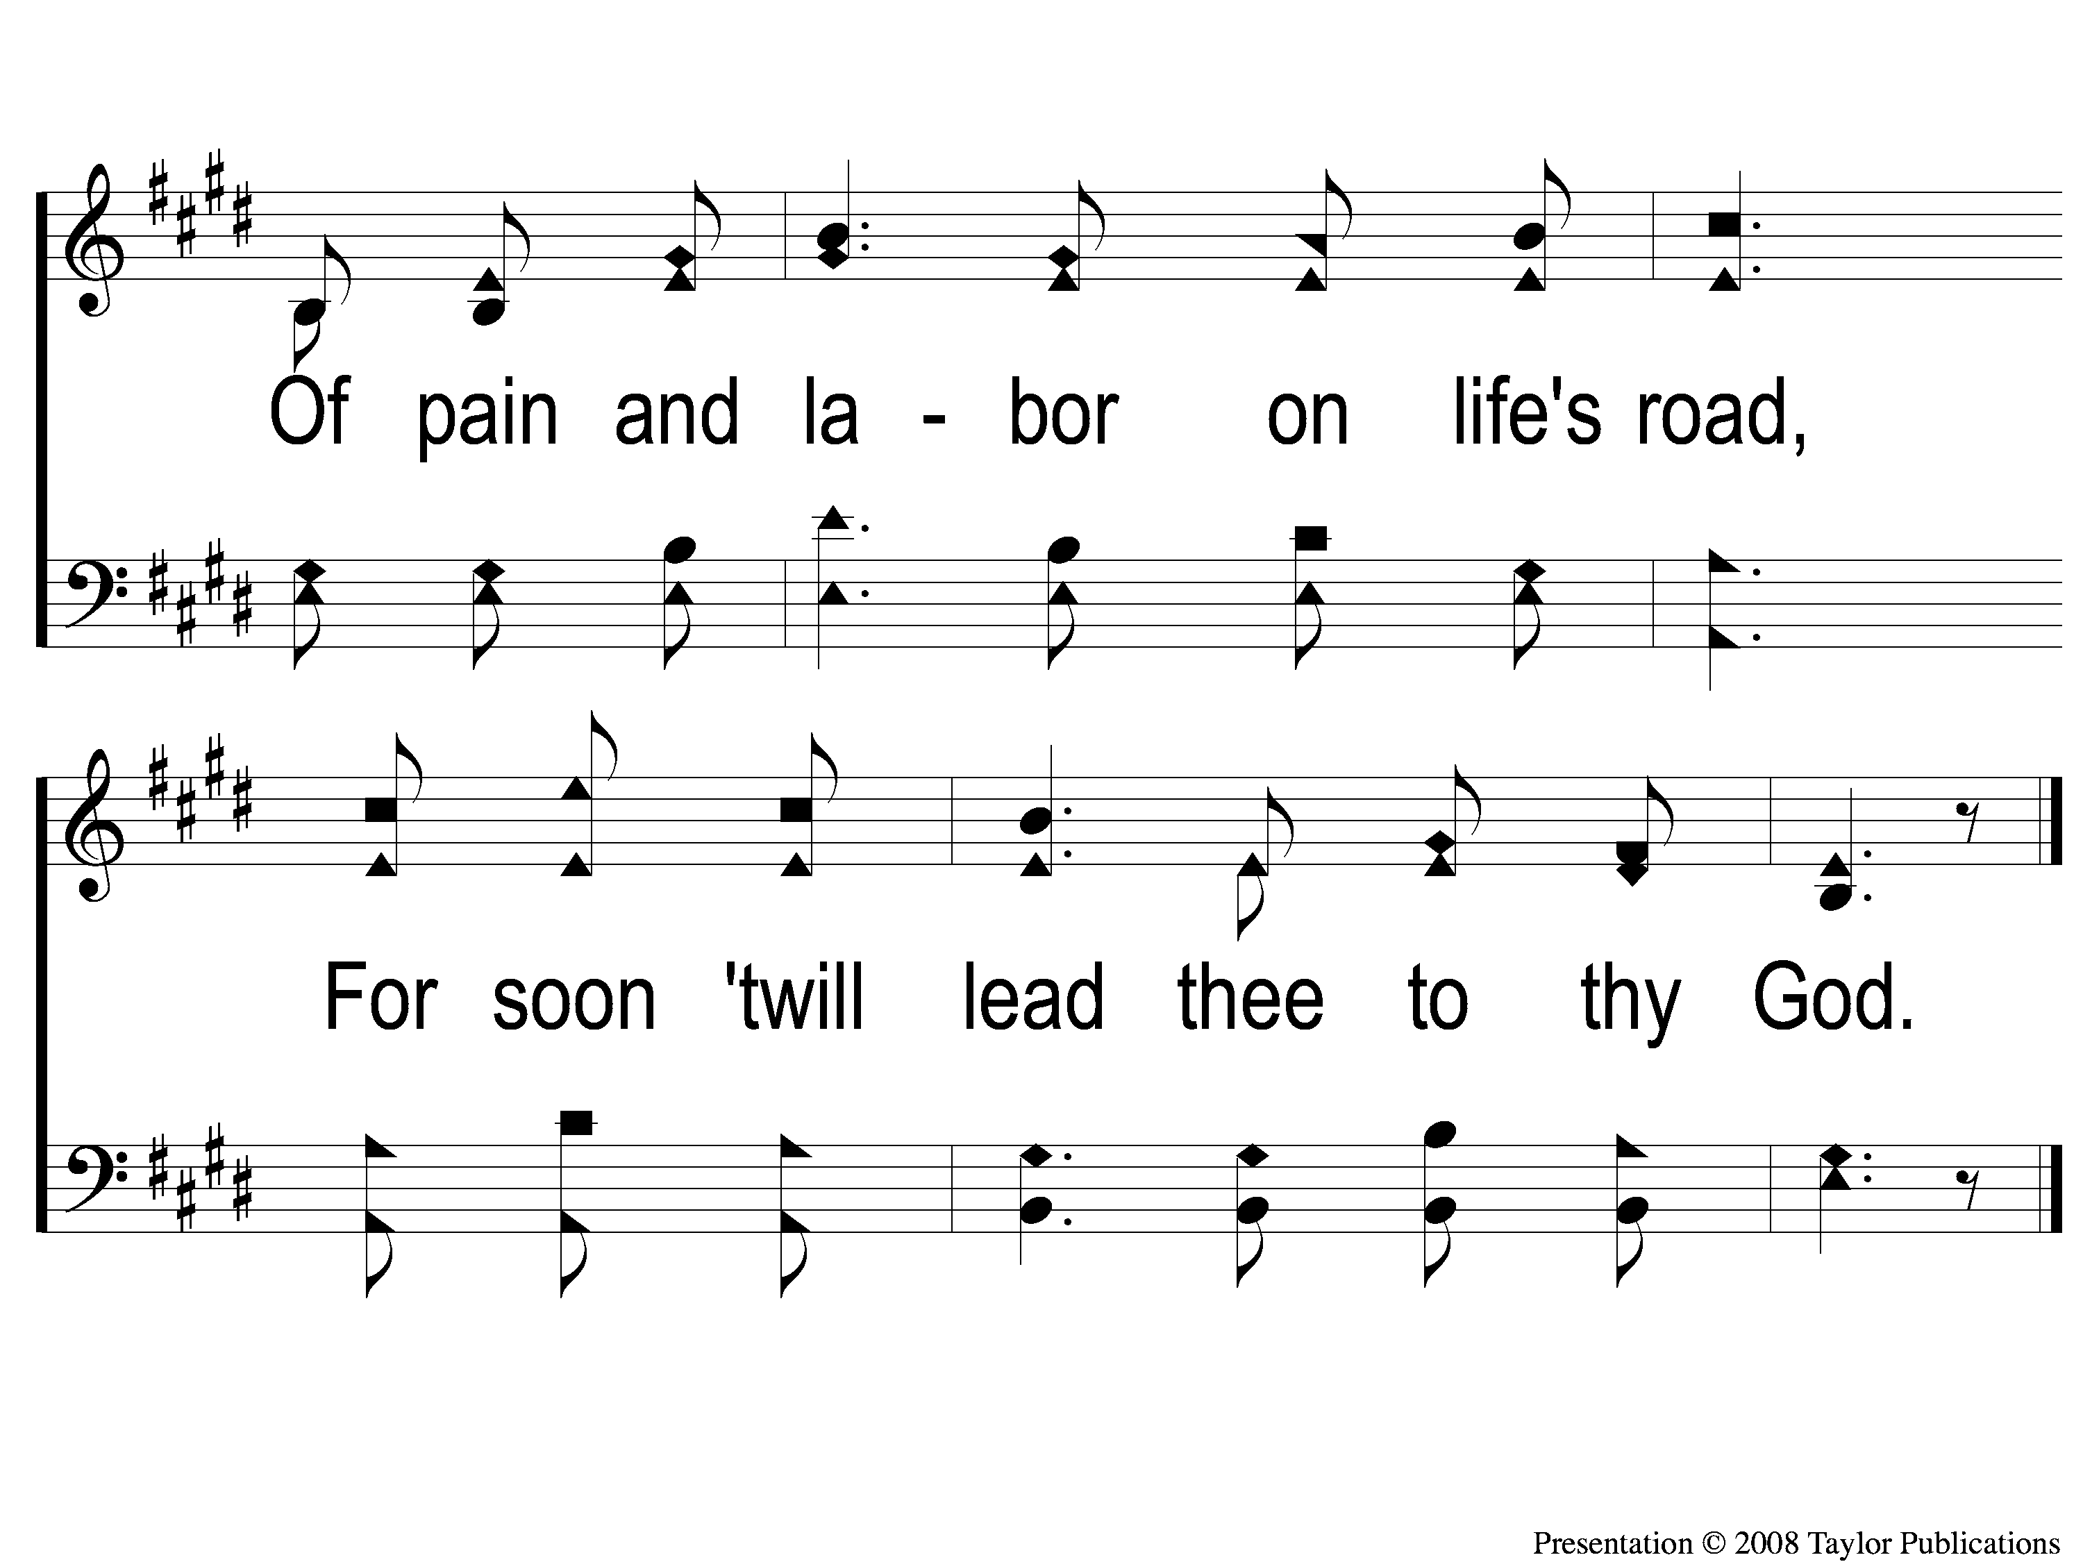
2-4 By and By
By and By
59

Slide 9
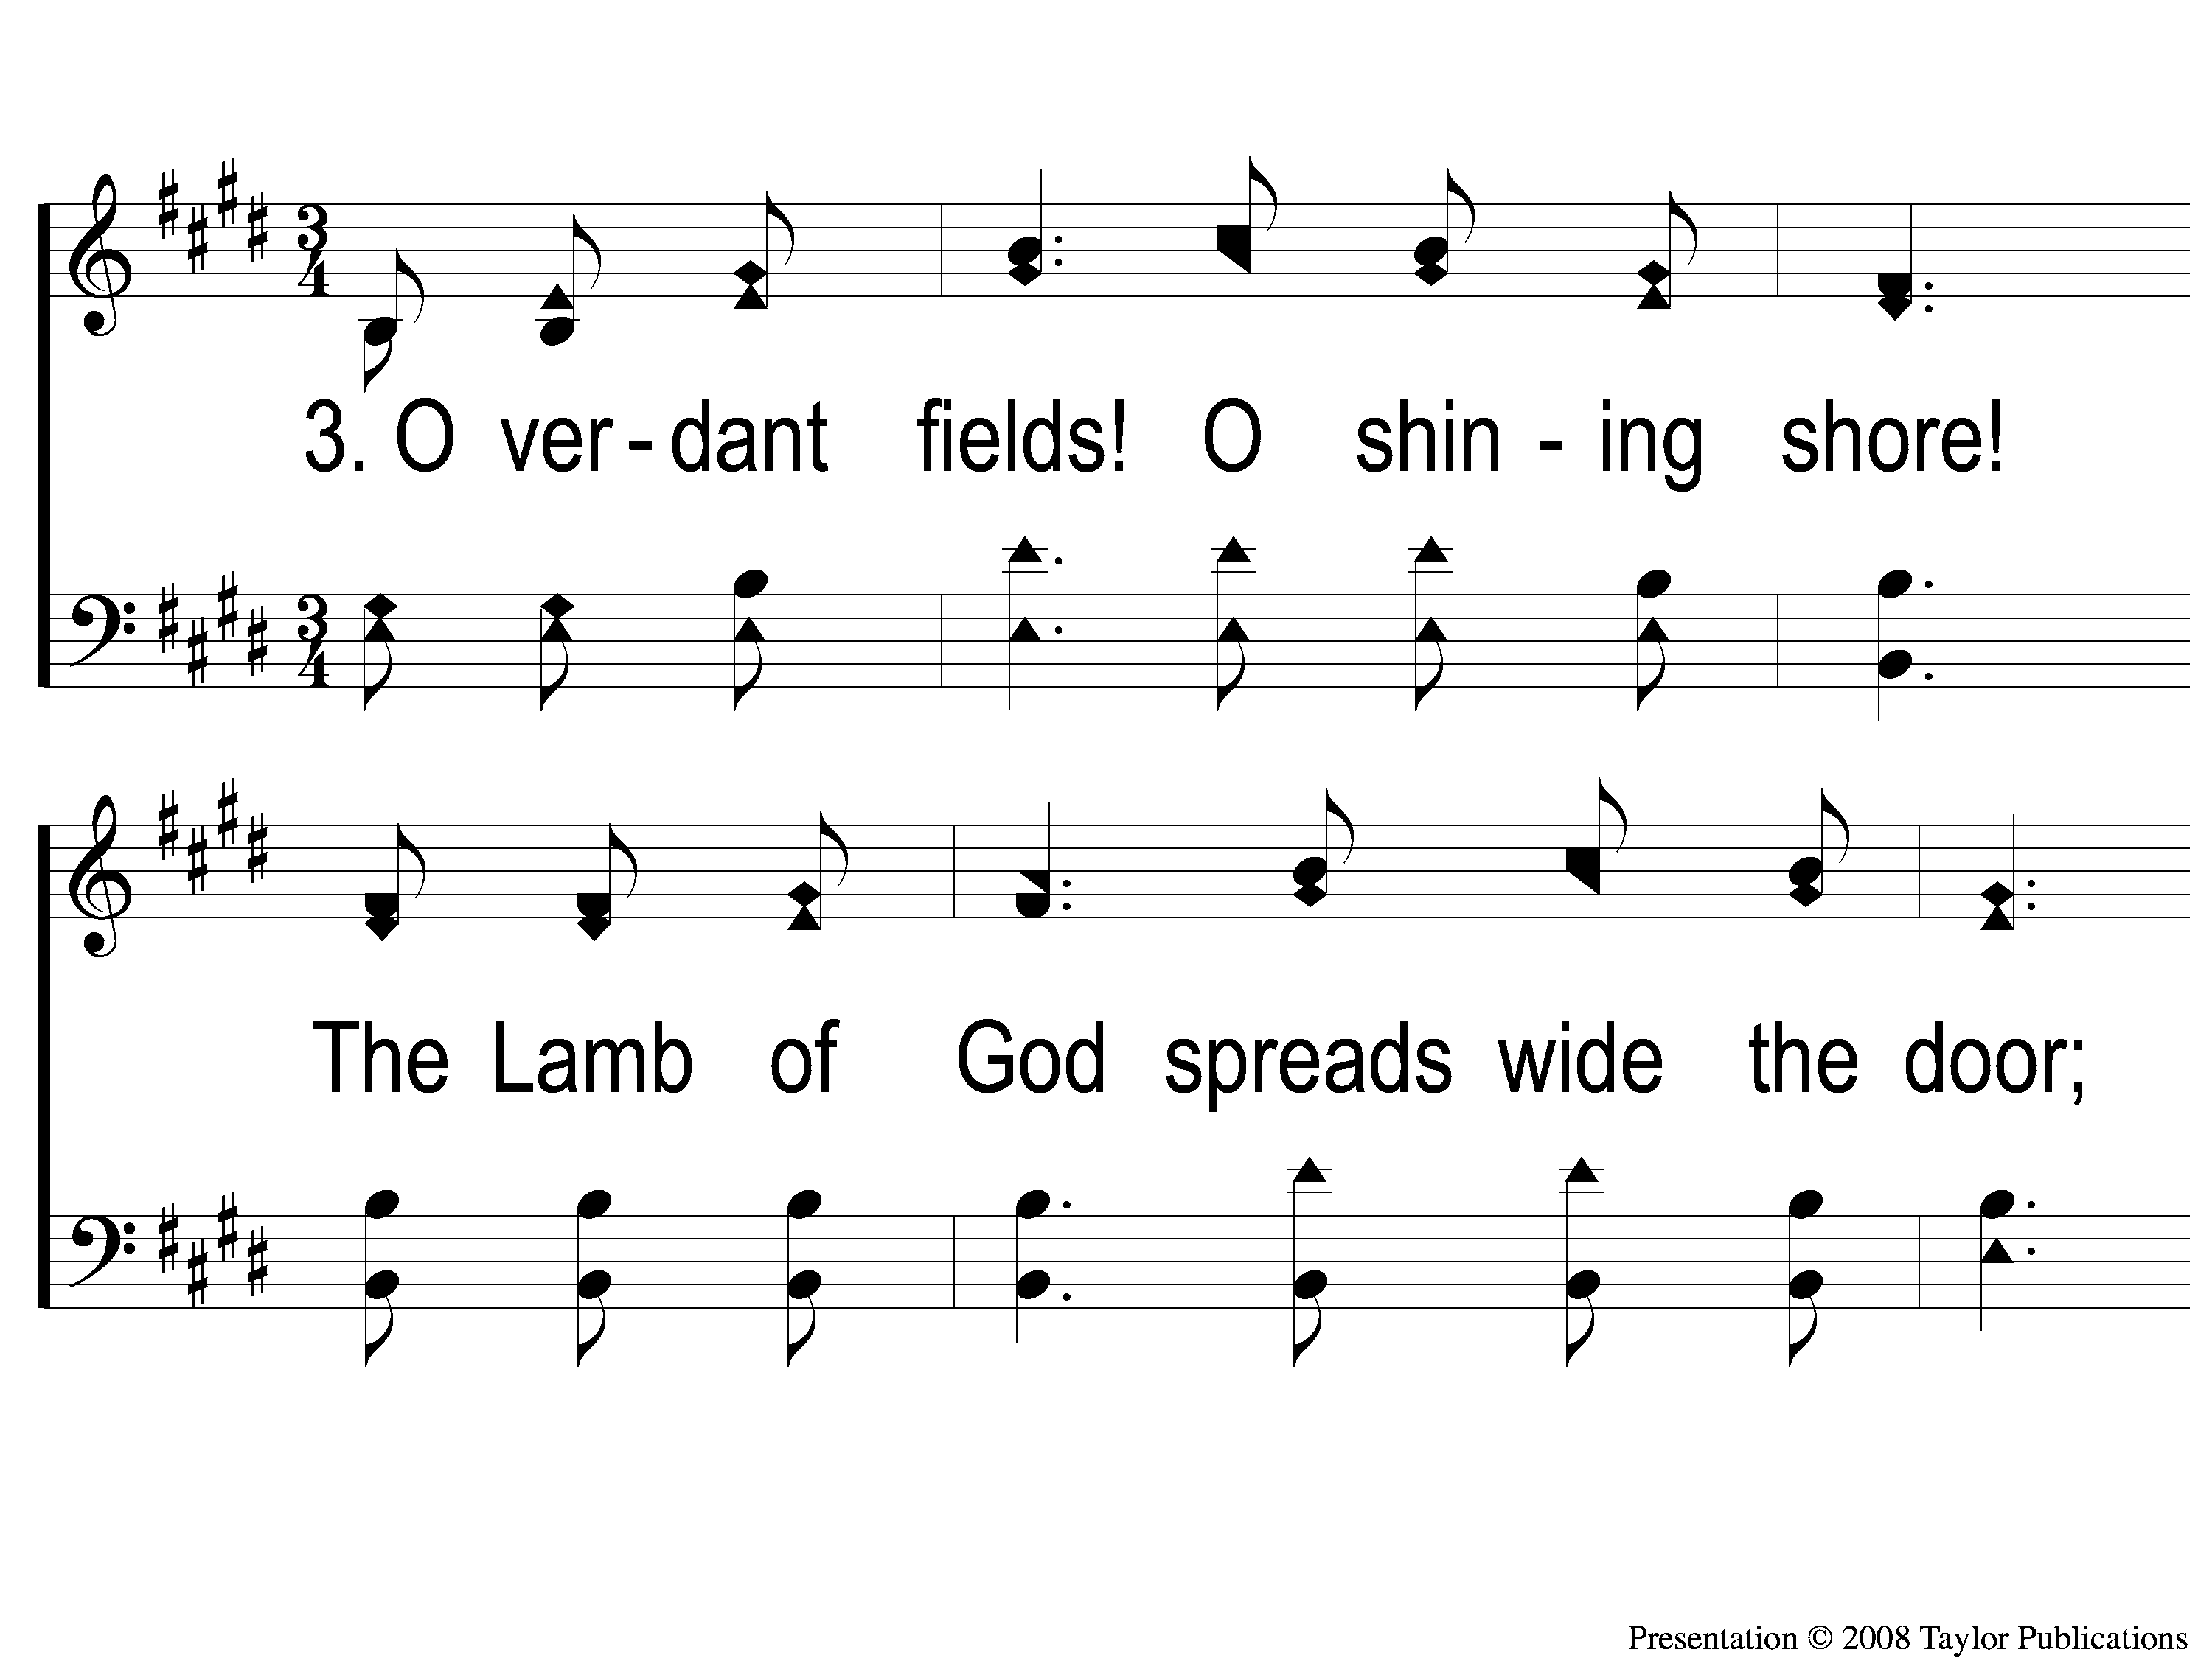
3-1 By and By
By and By
59

Slide 10
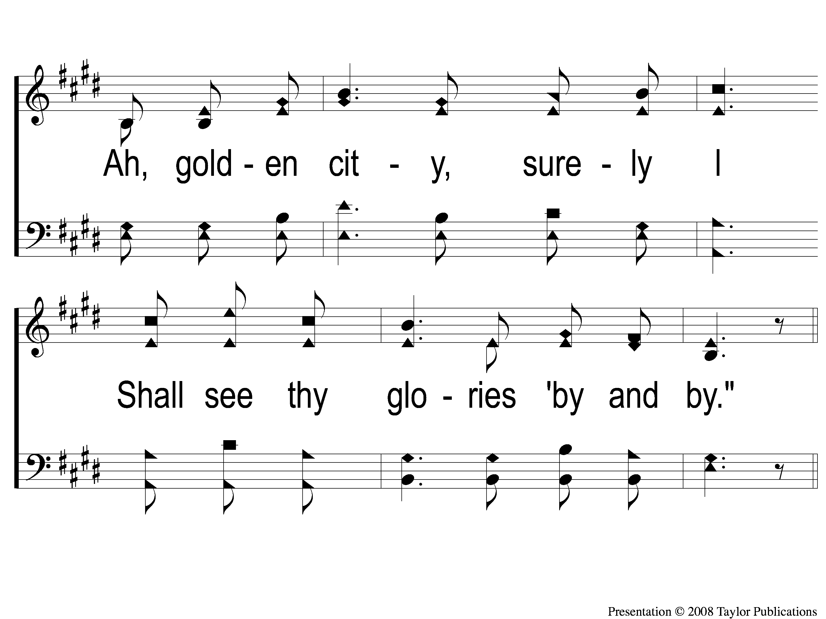
3-2 By and By
By and By
59

Slide 11
3-3 By and By
By and By
59

Slide 12
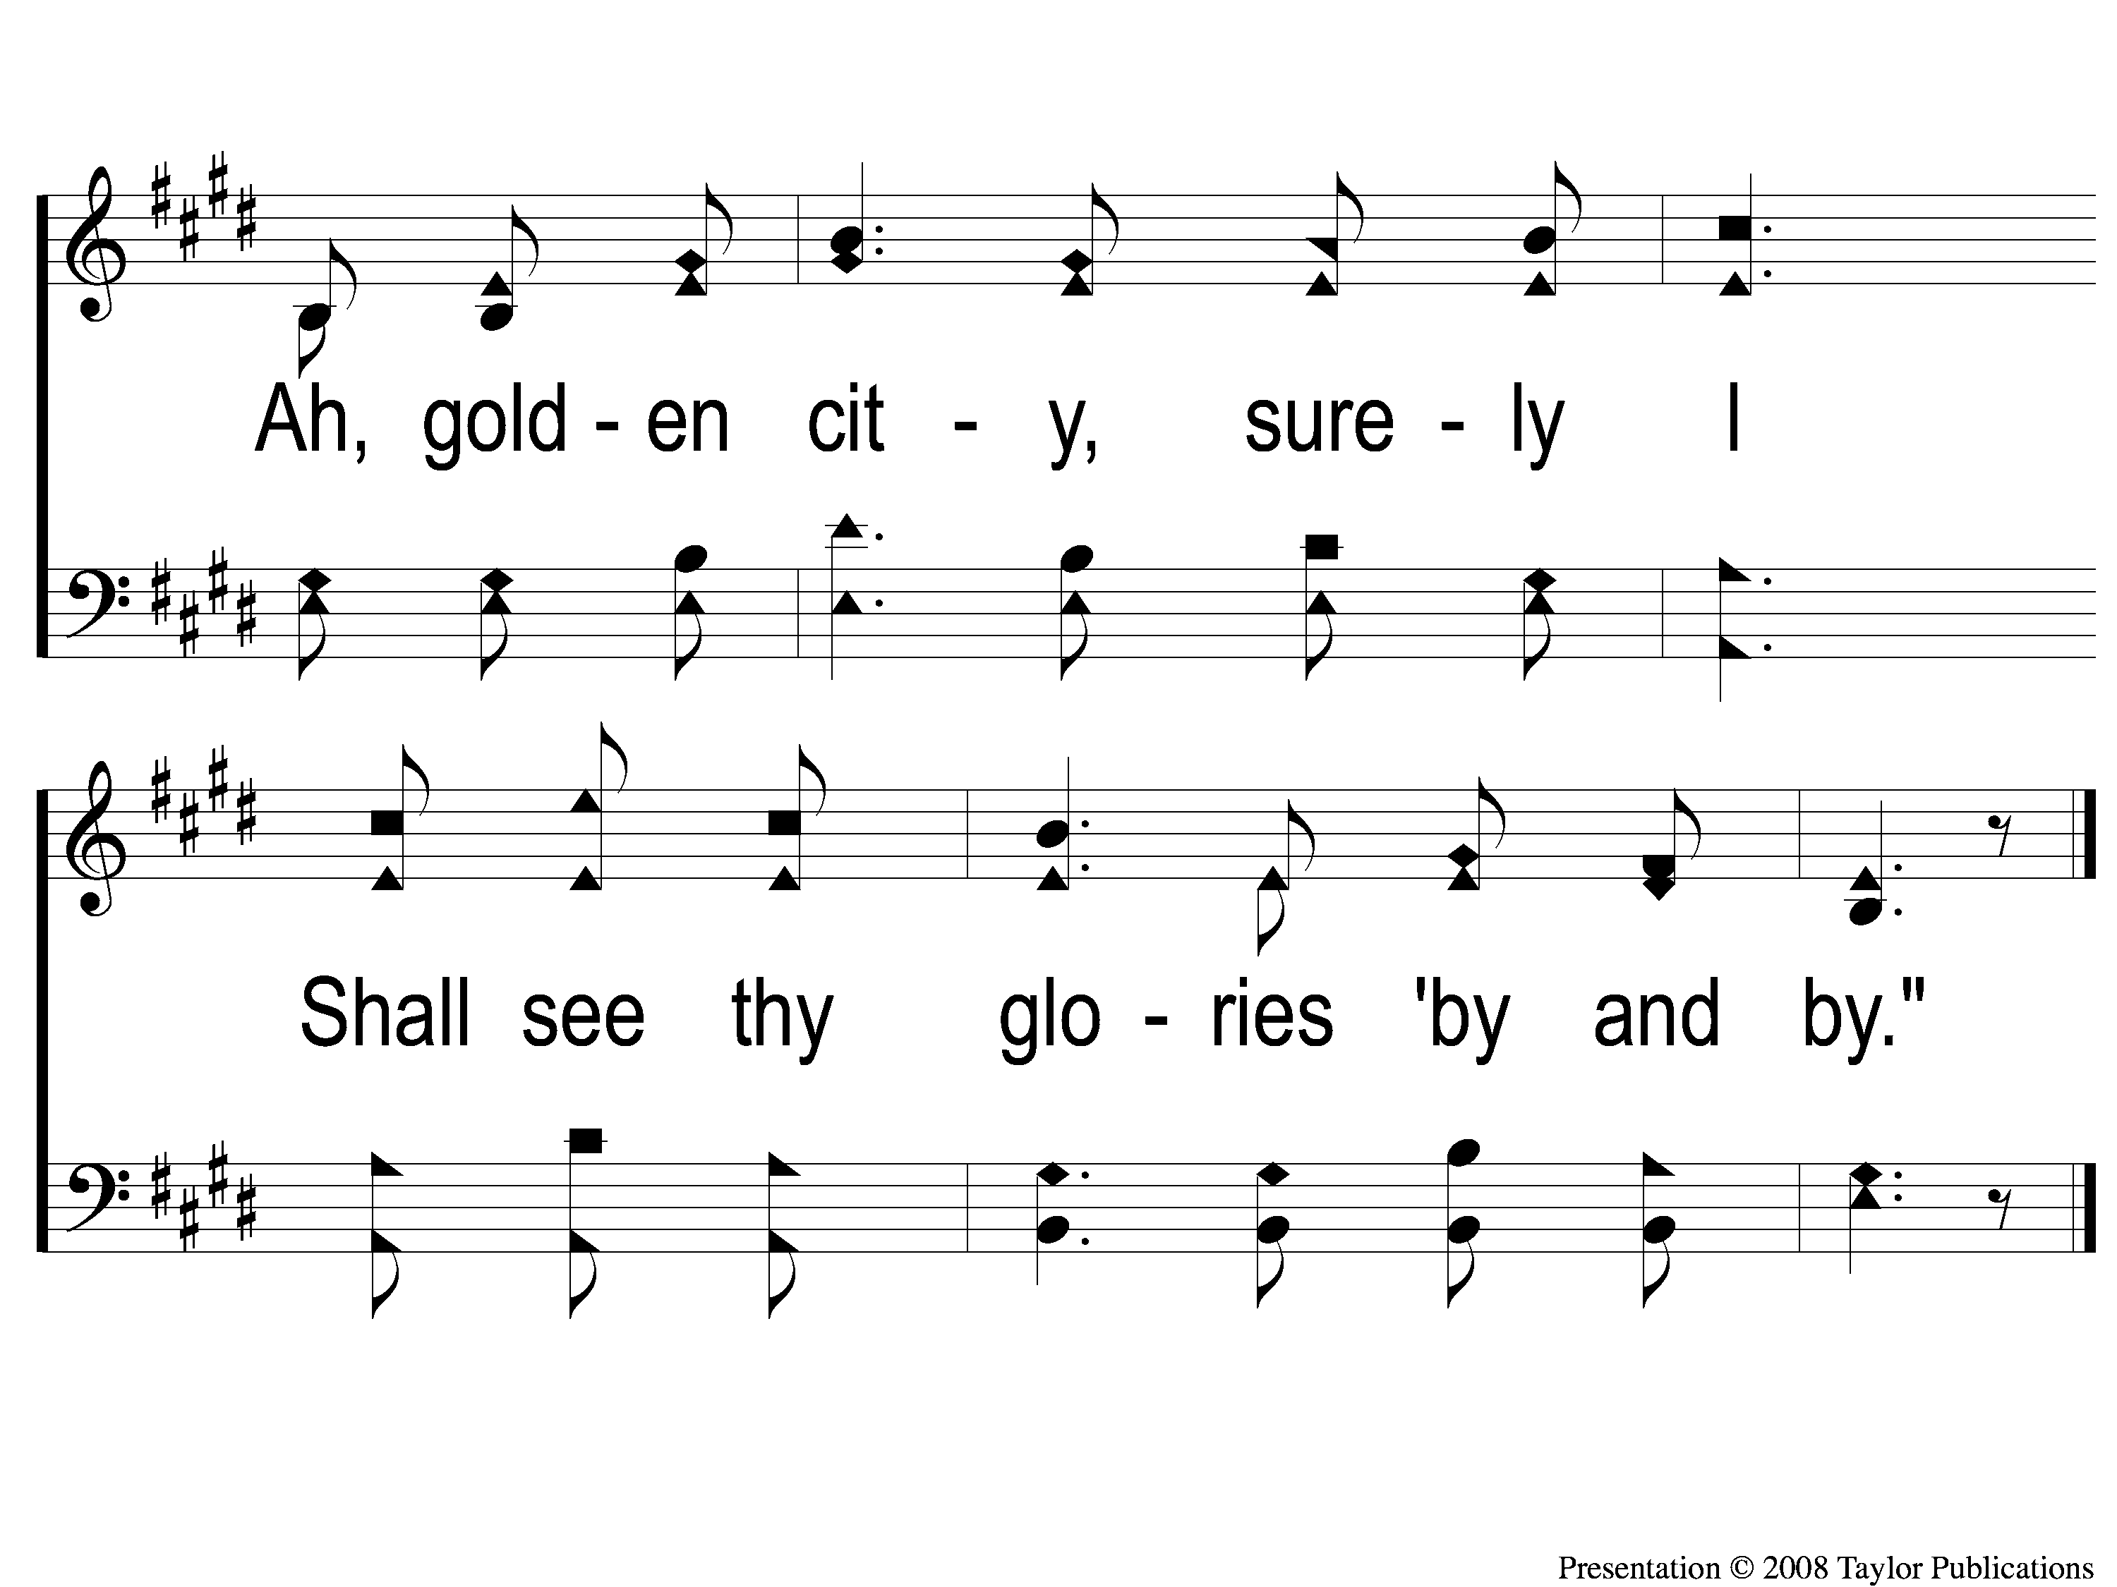
3-4 By and By
By and By
59

